Slide 1



Your Technology Guides
For the last 20 years
Enhancing Large Language Models(LLMs) with Tool Integrations for Dynamic capabilities
Ollama Tools for a “Personalized” RAG
Steve Brettschneider
Principal Consultant

Slide 2
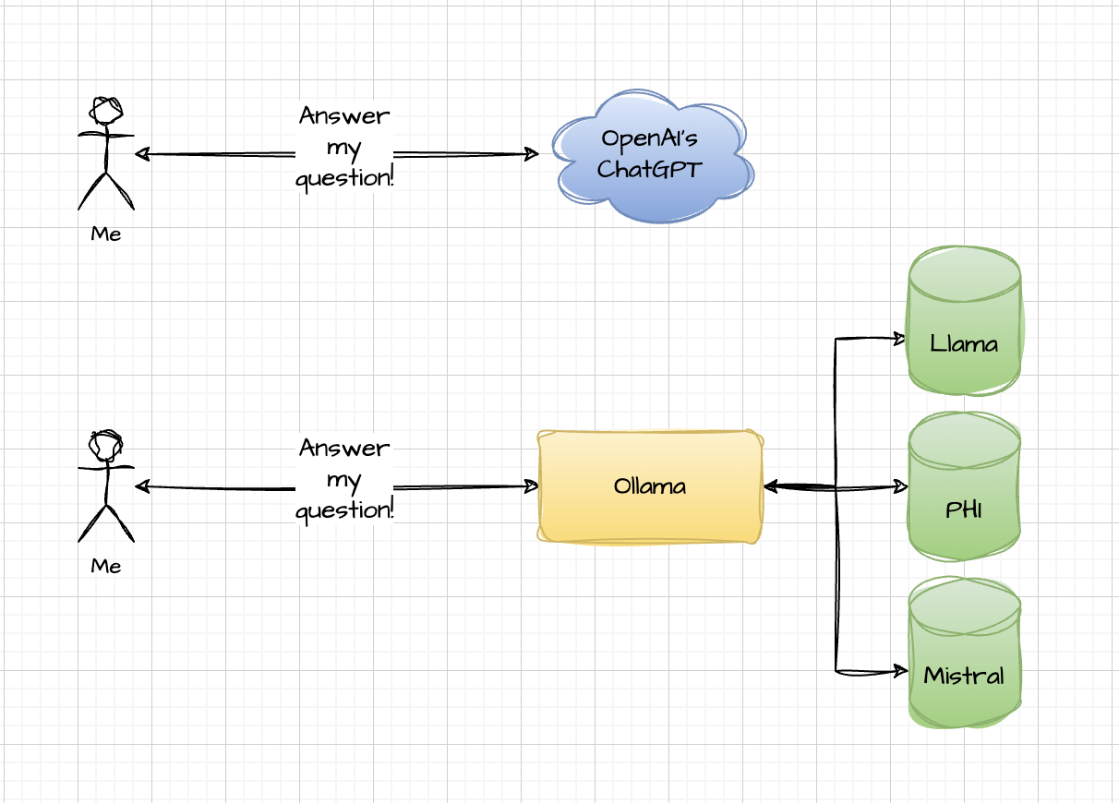
Evolution of Generative Language AI (From Steve’s Perspective)
Wait what?
Notes:
It exists! - Nifty but you can only do so much. For the most part, you’re limited to what the LLM already knows.
Is everyone familiar with what Ollama is?
Note – These diagrams will become more complex as we progress.

Slide 3
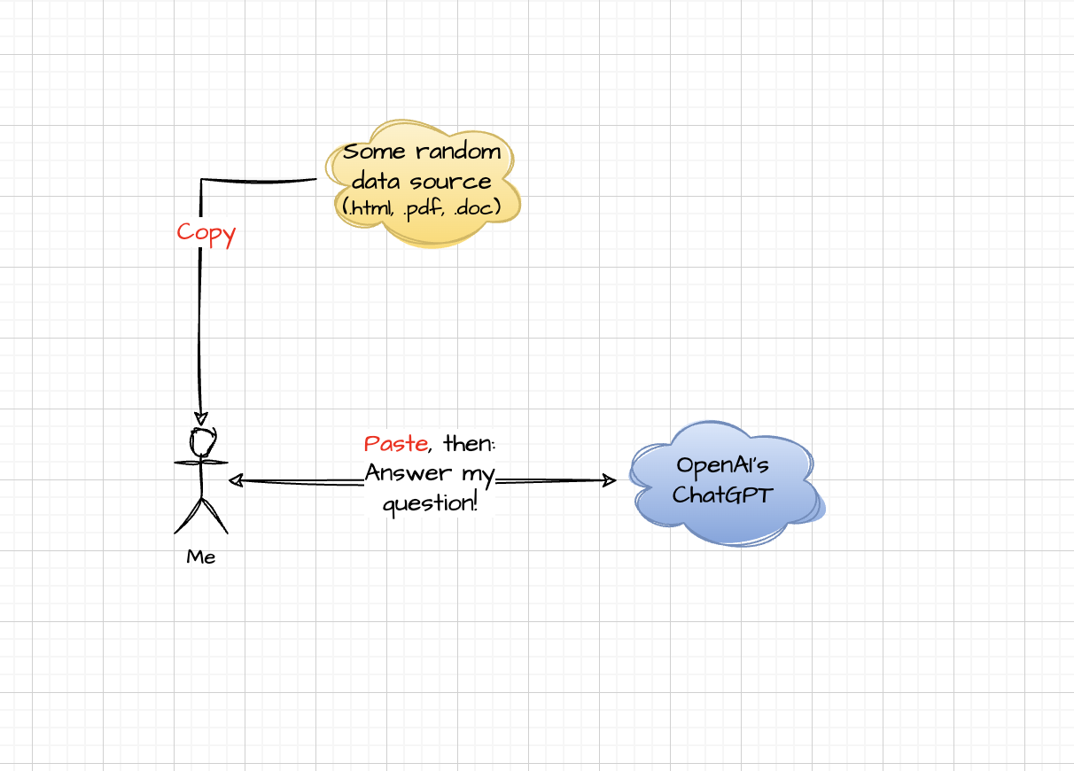
Evolution of Generative Language AI (From Steve’s Perspective)
Oh, you can do that?
Notes:
Copy/Paste Context - Better! You can dynamically add to what the LLM knows, but …
It’s tedious and manual.
Also, the creeping context-size problem starts.

Slide 4
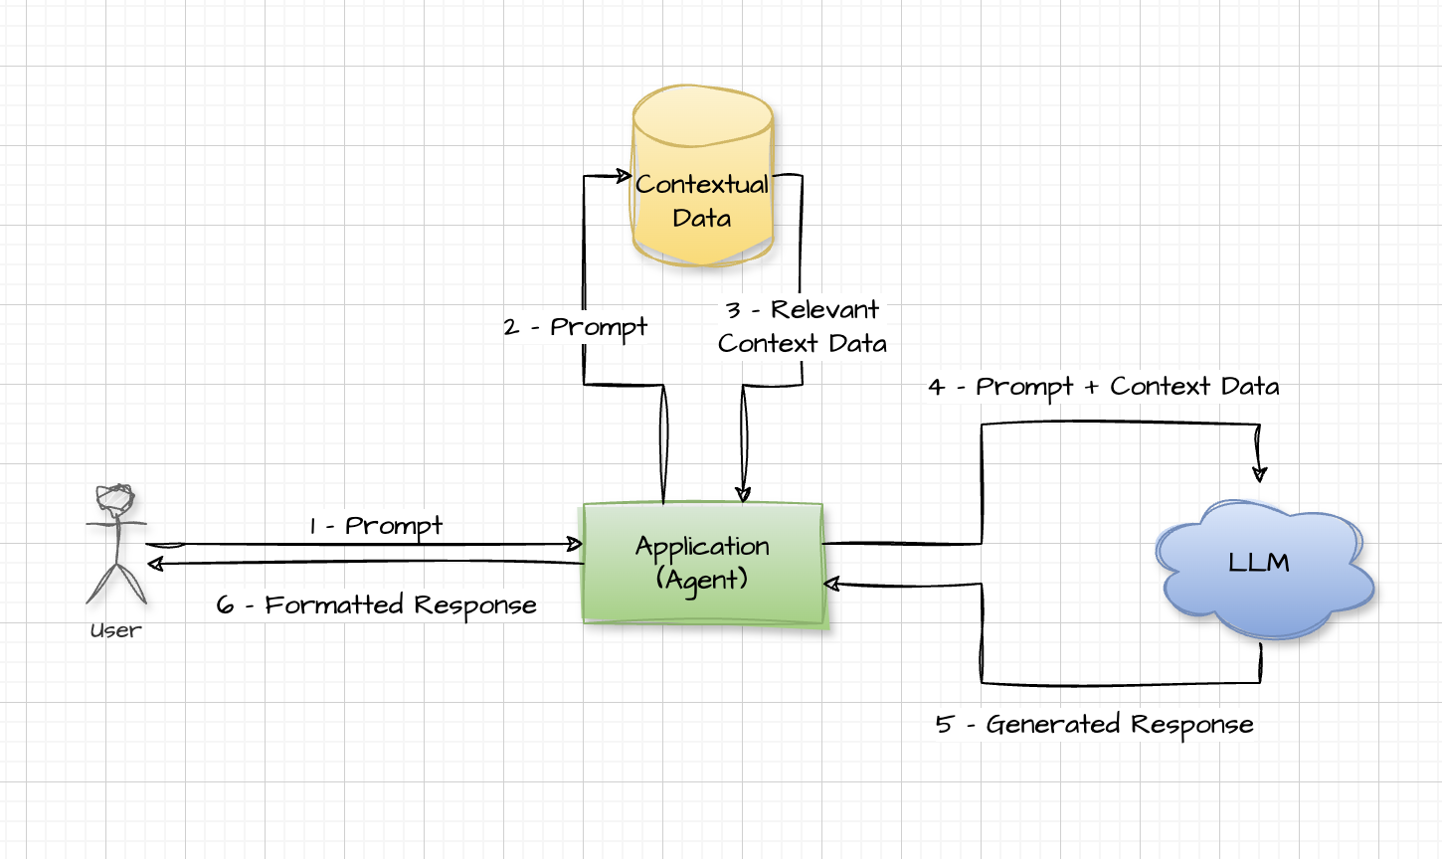
Evolution of Generative Language AI (From Steve’s Perspective)
Now we’re cookin’
Notes:
RAG – Automatic Context – but new issues:
What to retrieve?
VectorDB has CRUD issues
Other sources may be difficult to query with a prompt
Context-window size issue (lost in the middle problem)

Slide 5
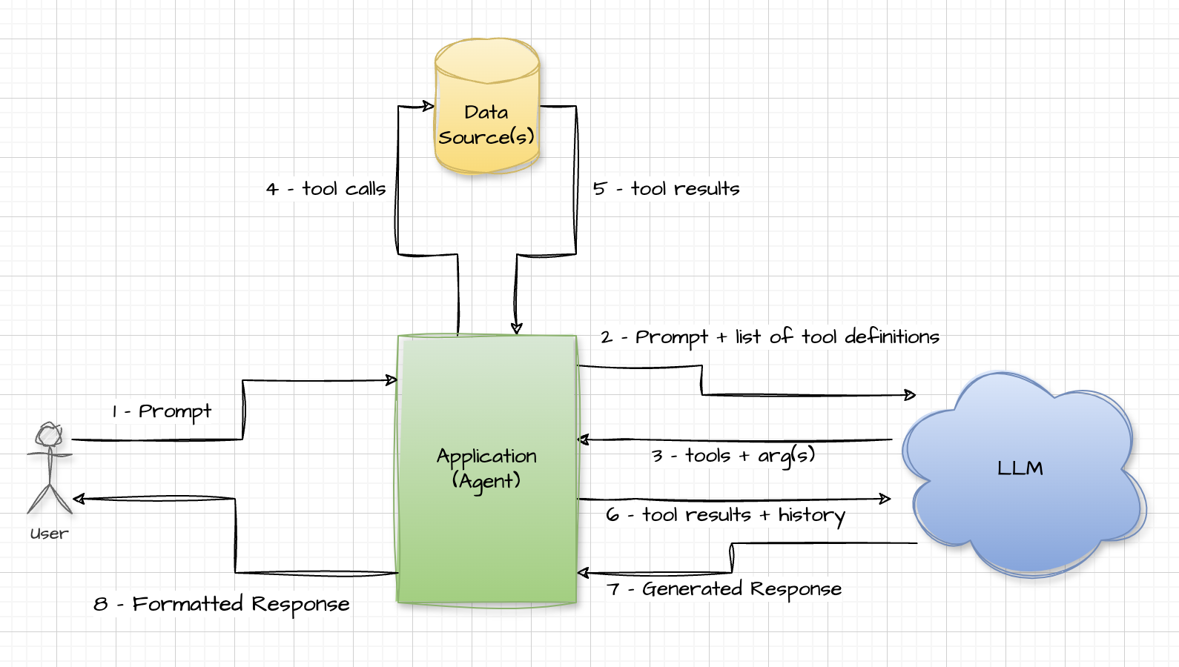
Evolution of Generative Language AI (From Steve’s Perspective)
Now we’re cookin’
…
with gas!
Notes:
Tools – RAG but more intelligent (phone a friend!):
The LLM decides what to ask for for additional context.
The LLM can choose what “tools” (aka functions) to execute to retrieve the extra context.
The LLM can even pick the arguments to pass to the “tools”.
Not perfect yet – but way better than the previous options.

Slide 6
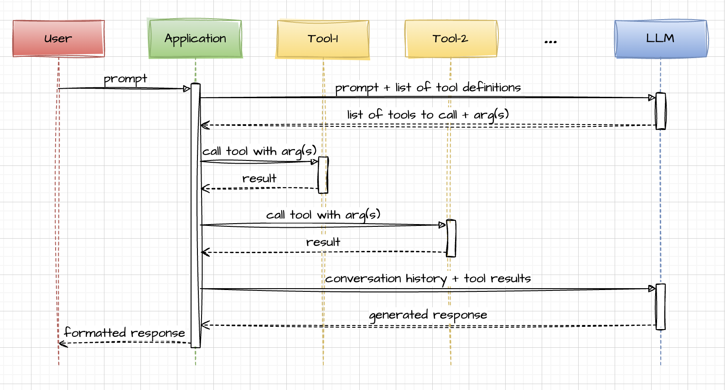
Evolution of Generative Language AI (From Steve’s Perspective)
Now we’re cookin’
…
with gas
Notes:
Tools – Just from a sequence diagram perspective.

Slide 7




More on Ollama Tools - Be a tool
OpenAI ”tools” and Gemini “functions” have been around for a little over a year. Ollama added support in July 2024.
More info at: https://ollama.com/blog/tool-support
Define application code (tool) to look up additional information (i.e., Python functions).
Tell the LLM about the functions, their parameters and their return values.
Present the LLM with a prompt.
LLM responds with request to execute one or more of the functions.
Execute the functions and send the results back to the LLM.
LLM uses the results to generate its final response.
Control of function call is maintained by your code (guardrails).
Ollama Tools
Gemini Functions
AWS Bedrock Tools
OpenAPI Functions

Slide 8
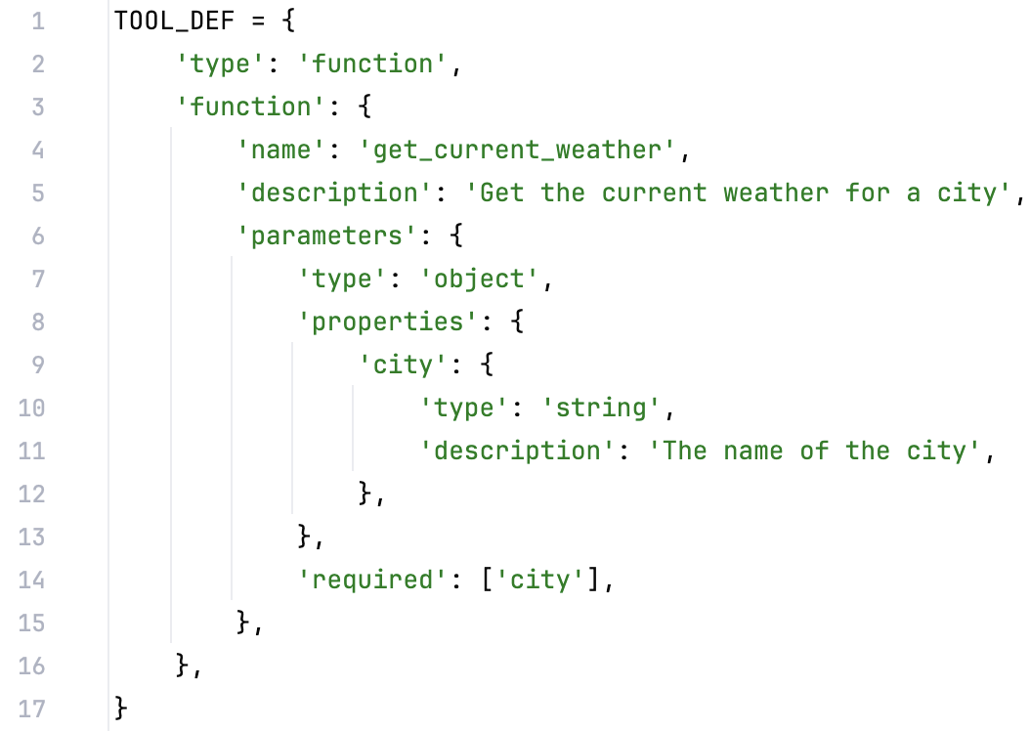
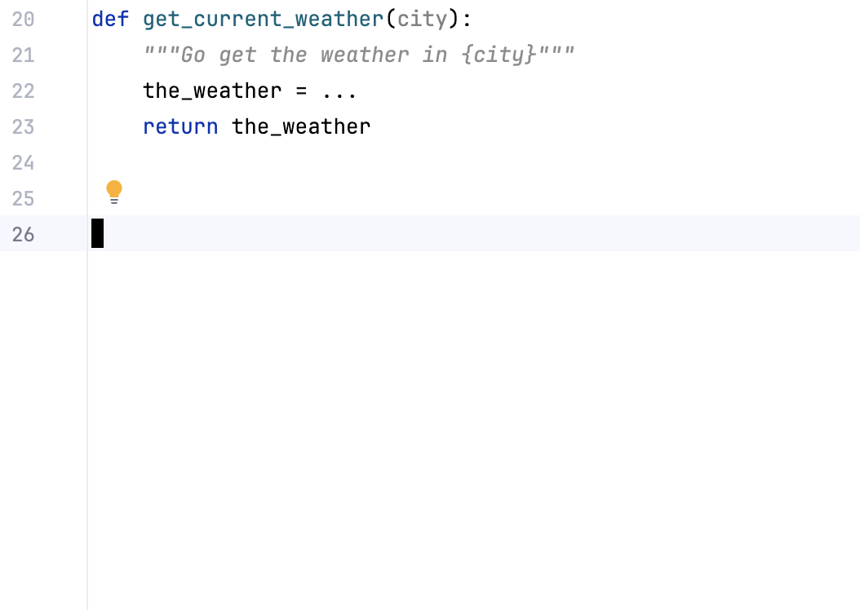
Anatomy of a Tool
Source: Ollama Blog

Slide 9
But wait… LLMs are stupid.
Jail breaking is a real problem.
Jail breaking is hard to prevent (it’s a cat and mouse game).
Fortunately, the LLM doesn’t actually execute the tool itself. It only asks for it to be executed. ^{(*disclaimer)}
The agent doesn’t have to be dumb.
The TOOL_DEF can be choosy about what parameters it allows the LLM to know about.
The agent can provide “private” parameters or override LLM provided parameters to add a layer of security/control.

Slide 10

Demo

Slide 11
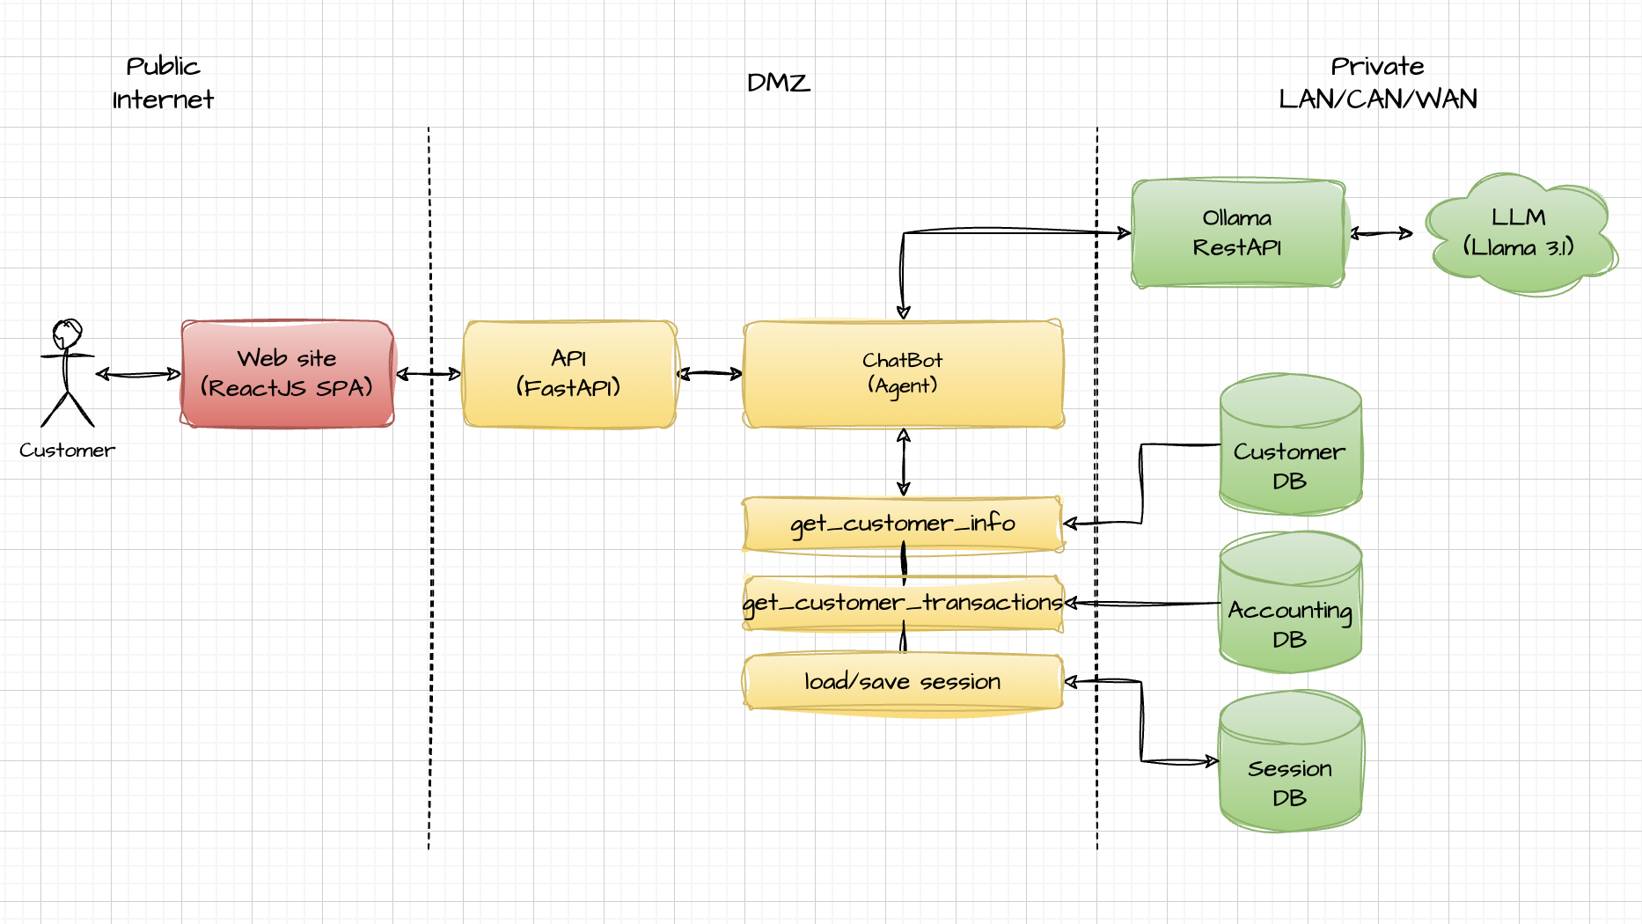
Demo Architecture

Slide 12
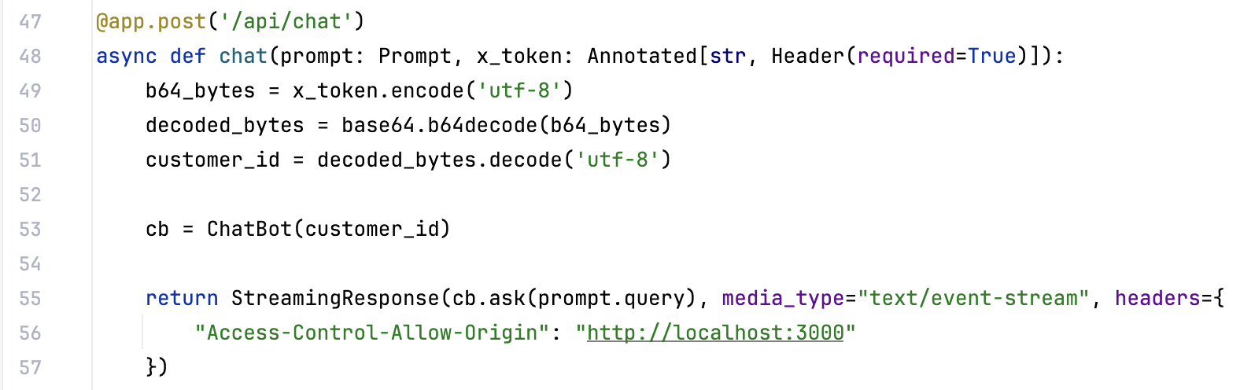
Code Review

Slide 13
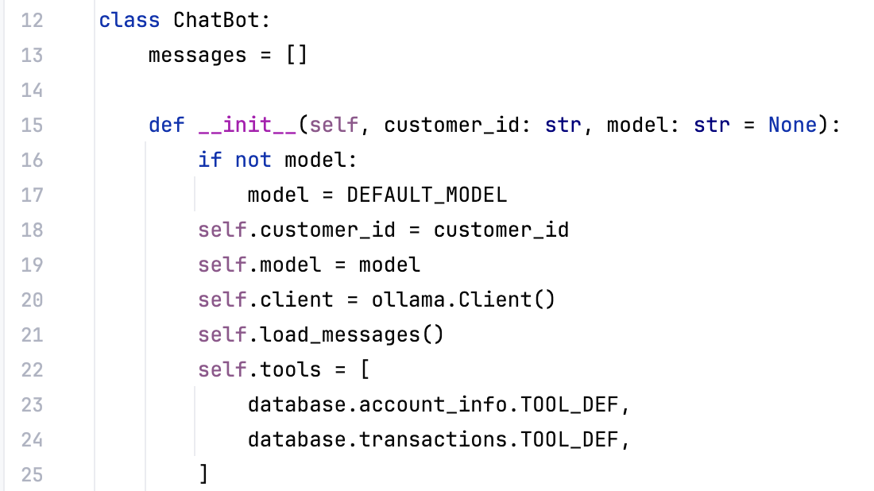
Code Review

Slide 14
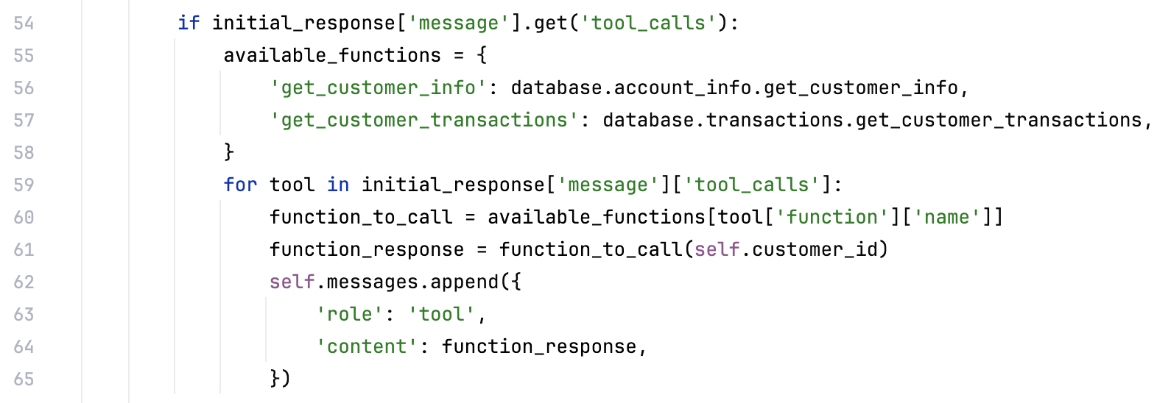

Code Review

Slide 15

Let’s land this plane
The LLM is the most important part of a generative AI solution, but it’s not the ONLY part.
Tools/RAG give the LLM more context awareness for a richer, fuller and more accurate experience.
The tool ecosystem that surrounds the LLM should be rich and plentiful. They should conform to the systems that they surface information from.
Agents/Applications bring it all together.
Agents/Applications should actively play the role of “gatekeeper” for security and privacy.
The full source code for this demo app can be found at: https://github.com/brettschneider/ai-ohio-psychics
Questions? - Discussion
Demo Code

Slide 16
Thank you

